Slide 1
Application layer: overview
Our goals:
conceptual and implementation aspects of application-layer protocols
  transport-layer service models
  client-server paradigm
  peer-to-peer paradigm
learn about protocols by examining popular application-layer protocols and infrastructure
  HTTP
  SMTP, IMAP
  DNS
  video streaming systems, CDNs

Slide 2
Some network apps
social networking
Web
text messaging
e-mail
multi-user network games
streaming stored video (YouTube, Hulu, Netflix)
P2P file sharing
voice over IP (e.g., Skype)
real-time video conferencing (e.g., Zoom)
Internet search
remote login
…
Q: your favorites?

Slide 3
















Creating a network app
application
transport
network
data link
physical
write programs that:
run on (different) end systems
communicate over network
e.g., web server software communicates with browser software
no need to write software for network-core devices
network-core devices do not run user applications
applications on end systems allows for rapid app development, propagation
mobile network
national or global ISP
local or regional ISP
home network
content
provider
network
application
transport
network
data link
physical
application
transport
network
data link
physical
datacenter
network
enterprise
network

Slide 4
Client-server paradigm
server:
always-on host
permanent IP address
often in data centers, for scaling
clients:
contact, communicate with server
may be intermittently connected
may have dynamic IP addresses
do not communicate directly with each other
examples: HTTP, IMAP, FTP
mobile network
national or global ISP
local or regional ISP
home network
content
provider
network
datacenter
network
enterprise
network

Slide 5
Peer-peer architecture
no always-on server
arbitrary end systems directly communicate
peers request service from other peers, provide service in return to other peers
peers are intermittently connected and change IP addresses
  complex management
example: P2P file sharing
mobile network
national or global ISP
local or regional ISP
home network
content
provider
network
datacenter
network
enterprise
network

Slide 6
Processes communicating
process: program running within a host
within same host, two processes communicate using inter-process communication (defined by OS)
processes in different hosts communicate by exchanging messages
clients, servers
client process: process that initiates communication
server process: process that waits to be contacted
note: applications with P2P architectures have client processes & server processes

Slide 7

Sockets
process sends/receives messages to/from its socket
socket analogous to door
  sending process relies on transport infrastructure on other side of door to deliver message to socket at receiving process
  two sockets involved: one on each side
application
socket
application
controlled by
app developer
process
process
transport
transport
network
network
controlled
by OS
link
Internet
link
physical
physical

Slide 8
Addressing processes
to receive messages, process must have identifier
host device has unique 32-bit IP address
Q: does IP address of host on which process runs suffice for identifying the process?
identifier includes both IP address and port numbers associated with process on host.
example port numbers:
  HTTP server: 80
  mail server: 25
to send HTTP message to gaia.cs.umass.edu web server:
  IP address: 128.119.245.12
  port number: 80
more shortly…
  A: no, many processes can be running on same host

Slide 9
An application-layer protocol defines:
types of messages exchanged,
  e.g., request, response
message syntax:
  what fields in messages & how fields are delineated
message semantics
  meaning of information in fields
rules for when and how processes send & respond to messages
open protocols:
defined in RFCs, everyone has access to protocol definition
allows for interoperability
e.g., HTTP, SMTP
proprietary protocols:
e.g., Skype, Zoom

Slide 10
What transport service does an app need?
data integrity
some apps (e.g., file transfer, web transactions) require 100% reliable data transfer
other apps (e.g., audio) can tolerate some loss
throughput
some apps (e.g., multimedia) require minimum amount of throughput to be “effective”
other apps (“elastic apps”) make use of whatever throughput they get
timing
some apps (e.g., Internet telephony, interactive games) require low delay to be “effective”
security
encryption, data integrity, …

Slide 11
Transport service requirements: common apps
application
file transfer/download
e-mail
Web documents
real-time audio/video
streaming audio/video
interactive games
text messaging
data loss
no loss
no loss
no loss
loss-tolerant
loss-tolerant
loss-tolerant
no loss
throughput
elastic
elastic
elastic
audio: 5Kbps-1Mbps
video:10Kbps-5Mbps
same as above
Kbps+
elastic
time sensitive?
no
no
no
yes, 10’s msec
yes, few secs
yes, 10’s msec
yes and no

Slide 12
Internet transport protocols services
TCP service:
reliable transport between sending and receiving process
flow control: sender won’t overwhelm receiver
congestion control: throttle sender when network overloaded
connection-oriented: setup required between client and server processes
does not provide: timing, minimum throughput guarantee, security
UDP service:
unreliable data transfer between sending and receiving process
does not provide: reliability, flow control, congestion control, timing, throughput guarantee, security, or connection setup.
Q: why bother? Why is there a UDP?

Slide 13
Internet applications, and transport protocols
application
layer protocol
FTP [RFC 959]
SMTP [RFC 5321]
HTTP 1.1 [RFC 7320]
SIP [RFC 3261], RTP [RFC 3550], or proprietary HTTP [RFC 7320], DASH
WOW, FPS (proprietary)
application
file transfer/download
e-mail
Web documents
Internet telephony
streaming audio/video
interactive games
transport protocol
TCP
TCP
TCP
TCP or UDP
TCP
UDP or TCP

Slide 14
Web and HTTP
First, a quick review…
web page consists of objects, each of which can be stored on different Web servers
object can be HTML file, JPEG image, Java applet, audio file,…
web page consists of base HTML-file which includes several referenced objects, each addressable by a URL, e.g.,
www.someschool.edu/someDept/pic.gif
host name
path name

Slide 15

HTTP overview
HTTP: hypertext transfer protocol
Web’s application-layer protocol
client/server model:
  client: browser that requests, receives, (using HTTP protocol) and “displays” Web objects
  server: Web server sends (using HTTP protocol) objects in response to requests
HTTP request
PC running
Firefox browser
HTTP response
HTTP request
server running
Apache Web
server
HTTP response
iPhone running
Safari browser

Slide 16
HTTP overview (continued)
HTTP uses TCP:
client initiates TCP connection (creates socket) to server, port 80
server accepts TCP connection from client
HTTP messages (application-layer protocol messages) exchanged between browser (HTTP client) and Web server (HTTP server)
TCP connection closed
HTTP is “stateless”
server maintains no information about past client requests

Slide 17
HTTP connections: two types
Non-persistent HTTP
TCP connection opened
at most one object sent over TCP connection
TCP connection closed
downloading multiple objects required multiple connections
Persistent HTTP
TCP connection opened to a server
multiple objects can be sent over single TCP connection between client, and that server
TCP connection closed

Slide 18
Non-persistent HTTP: example
User enters URL:
www.someSchool.edu/someDepartment/home.index
(containing text, references to 10 jpeg images)
1a. HTTP client initiates TCP connection to HTTP server (process) at www.someSchool.edu on port 80
1b. HTTP server at host www.someSchool.edu waiting for TCP connection at port 80 “accepts” connection, notifying client
2. HTTP client sends HTTP request message (containing URL) into TCP connection socket. Message indicates that client wants object someDepartment/home.index
3. HTTP server receives request message, forms response message containing requested object, and sends message into its socket
time

Slide 19
Non-persistent HTTP: example (cont.)
User enters URL:
www.someSchool.edu/someDepartment/home.index
(containing text, references to 10 jpeg images)
4. HTTP server closes TCP connection.
5. HTTP client receives response message containing html file, displays html. Parsing html file, finds 10 referenced jpeg objects
6. Steps 1-5 repeated for each of 10 jpeg objects
time

Slide 20
Non-persistent HTTP: response time
RTT (definition): time for a small packet to travel from client to server and back
HTTP response time (per object):
one RTT to initiate TCP connection
one RTT for HTTP request and first few bytes of HTTP response to return
object/file transmission time
initiate TCP
connection
RTT
request file
RTT
time to
transmit
file
file received
time
time
Non-persistent HTTP response time = 2RTT+ file transmission time

Slide 21
Persistent HTTP (HTTP 1.1)
Non-persistent HTTP issues:
requires 2 RTTs per object
browsers often open multiple parallel TCP connections to fetch referenced objects in parallel
Persistent HTTP (HTTP1.1):
server leaves connection open after sending response
subsequent HTTP messages between same client/server sent over open connection
client sends requests as soon as it encounters a referenced object
as little as one RTT for all the referenced objects (cutting response time in half)

Slide 22
HTTP request message
two types of HTTP messages: request, response
HTTP request message:
  ASCII (human-readable format)
carriage return character
request line (GET, POST,
HEAD commands)
line-feed character
GET /index.html HTTP/1.1\r\n
Host: www-net.cs.umass.edu\r\n
User-Agent: Mozilla/5.0 (Macintosh; Intel Mac OS X 10.15; rv:80.0) Gecko/20100101 Firefox/80.0 \r\n
Accept: text/html,application/xhtml+xml\r\n
Accept-Language: en-us,en;q=0.5\r\n
Accept-Encoding: gzip,deflate\r\n
Connection: keep-alive\r\n
\r\n
header
lines
carriage return, line feed at start of line indicates end of header lines
* Check out the online interactive exercises for more examples: http://gaia.cs.umass.edu/kurose_ross/interactive/

Slide 23
HTTP response message
status line (protocol
status code status phrase)
HTTP/1.1 200 OK
Date: Tue, 08 Sep 2020 00:53:20 GMT
Server: Apache/2.4.6 (CentOS) OpenSSL/1.0.2k-fips PHP/7.4.9 mod_perl/2.0.11 Perl/v5.16.3
Last-Modified: Tue, 01 Mar 2016 18:57:50 GMT
ETag: "a5b-52d015789ee9e"
Accept-Ranges: bytes
Content-Length: 2651
Content-Type: text/html; charset=UTF-8
\r\n
data data data data data ...
header
lines
data, e.g., requested
HTML file
* Check out the online interactive exercises for more examples: http://gaia.cs.umass.edu/kurose_ross/interactive/

Slide 24
HTTP response status codes
status code appears in 1st line in server-to-client response message.
some sample codes:
200 OK
  request succeeded, requested object later in this message
301 Moved Permanently
  requested object moved, new location specified later in this message (in Location: field)
400 Bad Request
  request msg not understood by server
404 Not Found
  requested document not found on this server
505 HTTP Version Not Supported

Slide 25

Maintaining user/server state: cookies
Recall: HTTP GET/response interaction is stateless
no notion of multi-step exchanges of HTTP messages to complete a Web “transaction”
  no need for client/server to track “state” of multi-step exchange
  all HTTP requests are independent of each other
  no need for client/server to “recover” from a partially-completed-but-never-completely-completed transaction
a stateful protocol: client makes two changes to X, or none at all
X
lock data record X
X
OK
update X X’
X’
OK
t’
update X X’’
OK
X’’
unlock X
OK
X’’
time
time
Q: what happens if network connection or client crashes at t’ ?
Notes:
t’

Slide 26
Maintaining user/server state: cookies
Web sites and client browser use cookies to maintain some state between transactions
four components:
  1) cookie header line of HTTP response message
  2) cookie header line in next HTTP request message
  3) cookie file kept on user’s host, managed by user’s browser
  4) back-end database at Web site
Example:
Susan uses browser on laptop, visits specific e-commerce site for first time
when initial HTTP requests arrives at site, site creates:
  unique ID (“cookie”)
  entry in backend database for ID
subsequent HTTP requests from Susan to this site will contain cookie ID value, allowing site to “identify” Susan
Notes:
t’

Slide 27
Maintaining user/server state: cookies
client
server
ebay 8734
usual HTTP request msg
Amazon server
creates ID
1678 for user
cookie file
usual HTTP response
set-cookie: 1678
backend
database
create
entry
ebay 8734
amazon 1678
usual HTTP request msg
cookie: 1678
cookie-
specific
action
access
usual HTTP response msg
one week later:
access
ebay 8734
amazon 1678
usual HTTP request msg
cookie: 1678
cookie-
specific
action
usual HTTP response msg
time
time
Notes:
t’

Slide 28
HTTP cookies: comments
aside
What cookies can be used for:
authorization
shopping carts
recommendations
user session state (Web e-mail)
cookies and privacy:
cookies permit sites to learn a lot about you on their site.
third party persistent cookies (tracking cookies) allow common identity (cookie value) to be tracked across multiple web sites
Challenge: How to keep state?
at protocol endpoints: maintain state at sender/receiver over multiple transactions
in messages: cookies inHTTP messages carry state
Notes:
t’

Slide 29
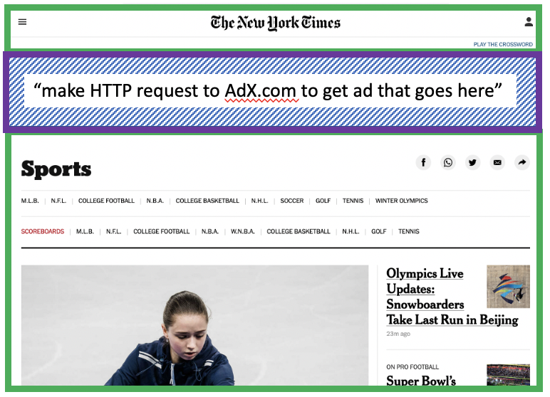
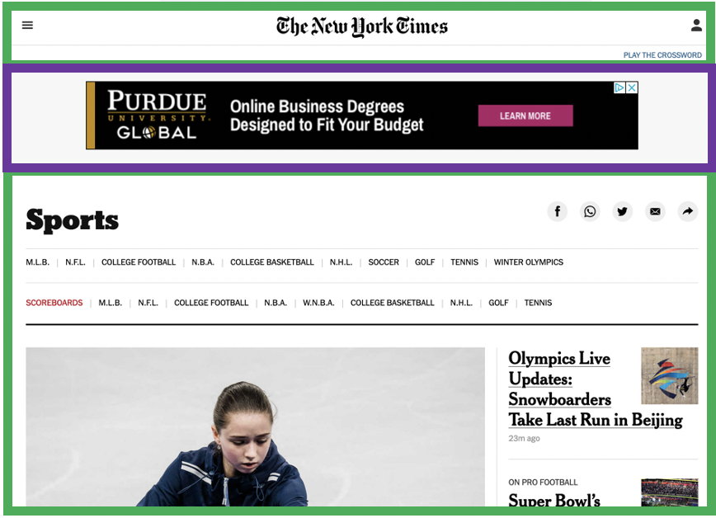


Example: displaying a NY Times web page
1
GET base html file from nytimes.com
2
fetch ad from AdX.com
nytimes.com
4
5
HTTP GET
1
2
HTTP reply
7
display composed page
3
4
6
5
NY times page with embedded ad displayed
AdX.com

Slide 30
Cookies: tracking a user’s browsing behavior
1634: sports, 2/15/22
nytimes.com (sports)
“first party” cookie – from website you chose to visit (provides base html file)
HTTP
GET
HTTP reply
Set cookie: 1634
HTTP GET
Referer: NY Times Sports
4
5
7493: NY Times sports, 2/15/22
“third party” cookie – from website you did not choose to visit
HTTP reply
NY Times: 1634
Set cookie: 7493
AdX.com
AdX: 7493

Slide 31
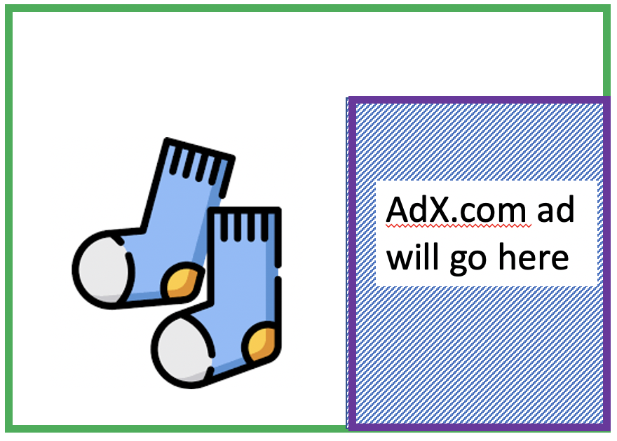
Cookies: tracking a user’s browsing behavior
1634: sports, 2/15/22
nytimes.com
AdX:
tracks my web browsing over sites with AdX ads
can return targeted ads based on browsing history
socks.com
HTTP reply
2
HTTP GET
1
HTTP GET
Referer: socks.com, cookie: 7493
4
7493: NY Times sports, 2/15/22
5
7493: socks.com, 2/16/22
HTTP reply
NY Times: 1634
Set cookie: 7493
AdX.com
AdX: 7493

Slide 32

Cookies: tracking a user’s browsing behavior (one day later)
1634: sports, 2/15/22
1634: arts, 2/17/22
nytimes.com (arts)
socks.com
HTTP
GET
HTTP reply
cookie: 1634
Set cookie: 1634
HTTP GET
Referer:nytimes.com, cookie: 7493
4
7493: NY Times sports, 2/15/22
5
7493: socks.com, 2/16/22
HTTP reply
7493: NY Times arts, 2/15/22
NY Times: 1634
Set cookie: 7493
AdX.com
AdX: 7493
Returned ad for socks!

Slide 33
Cookies: tracking a user’s browsing behavior
Cookies can be used to:
track user behavior on a given website (first party cookies)
track user behavior across multiple websites (third party cookies) without user ever choosing to visit tracker site (!)
tracking may be invisible to user:
  rather than displayed ad triggering HTTP GET to tracker, could be an invisible link
third party tracking via cookies:
disabled by default in Firefox, Safari browsers
to be disabled in Chrome browser in 2023

Slide 34

Web caches
Goal: satisfy client requests without involving origin server
user configures browser to point to a (local) Web cache
browser sends all HTTP requests to cache
  if object in cache: cache returns object to client
  else cache requests object from origin server, caches received object, then returns object to client
Web
cache
HTTP request
HTTP request
client
HTTP response
HTTP response
origin
server
HTTP request
HTTP response
client
Notes:
t’

Slide 35
Web caches (proxy servers)
Web cache acts as both client and server
  server for original requesting client
  client to origin server
Why Web caching?
reduce response time for client request
  cache is closer to client
reduce traffic on an institution’s access link
Internet is dense with caches
  enables “poor” content providers to more effectively deliver content
Notes:
re: poor content providers – like in real-estate, location is everything. servers want to be close to clients.

Slide 36
HTTP/2: mitigating HOL blocking
HTTP 1.1: client requests 1 large object (e.g., video file) and 3 smaller objects
server
GET O₄
GET O₃
GET O₂
GET O₁
object data requested
client
O₁
O₂
O₁
O₃
O₂
O₃
O₄
O₄
objects delivered in order requested: O₂, O₃, O₄ wait behind O₁
Notes:
t’

Slide 37
HTTP/2: mitigating HOL blocking
HTTP/2: objects divided into frames, frame transmission interleaved
server
GET O₄
GET O₃
GET O₂
GET O₁
object data requested
client
O₂
O₄
O₃
O₁
O₂
O₃
O₄
O₁
O₂, O₃, O₄ delivered quickly, O₁ slightly delayed
Notes:
shortest job first: decreased average delay!

Slide 38
HTTP/2 to HTTP/3
HTTP/2 over single TCP connection means:
recovery from packet loss still stalls all object transmissions
  as in HTTP 1.1, browsers have incentive to open multiple parallel TCP connections to reduce stalling, increase overall throughput
HTTP/3: adds security, per object error- and congestion-control (more pipelining) over UDP
  more on HTTP/3 in transport layer
Notes:
t’

